Slide 1
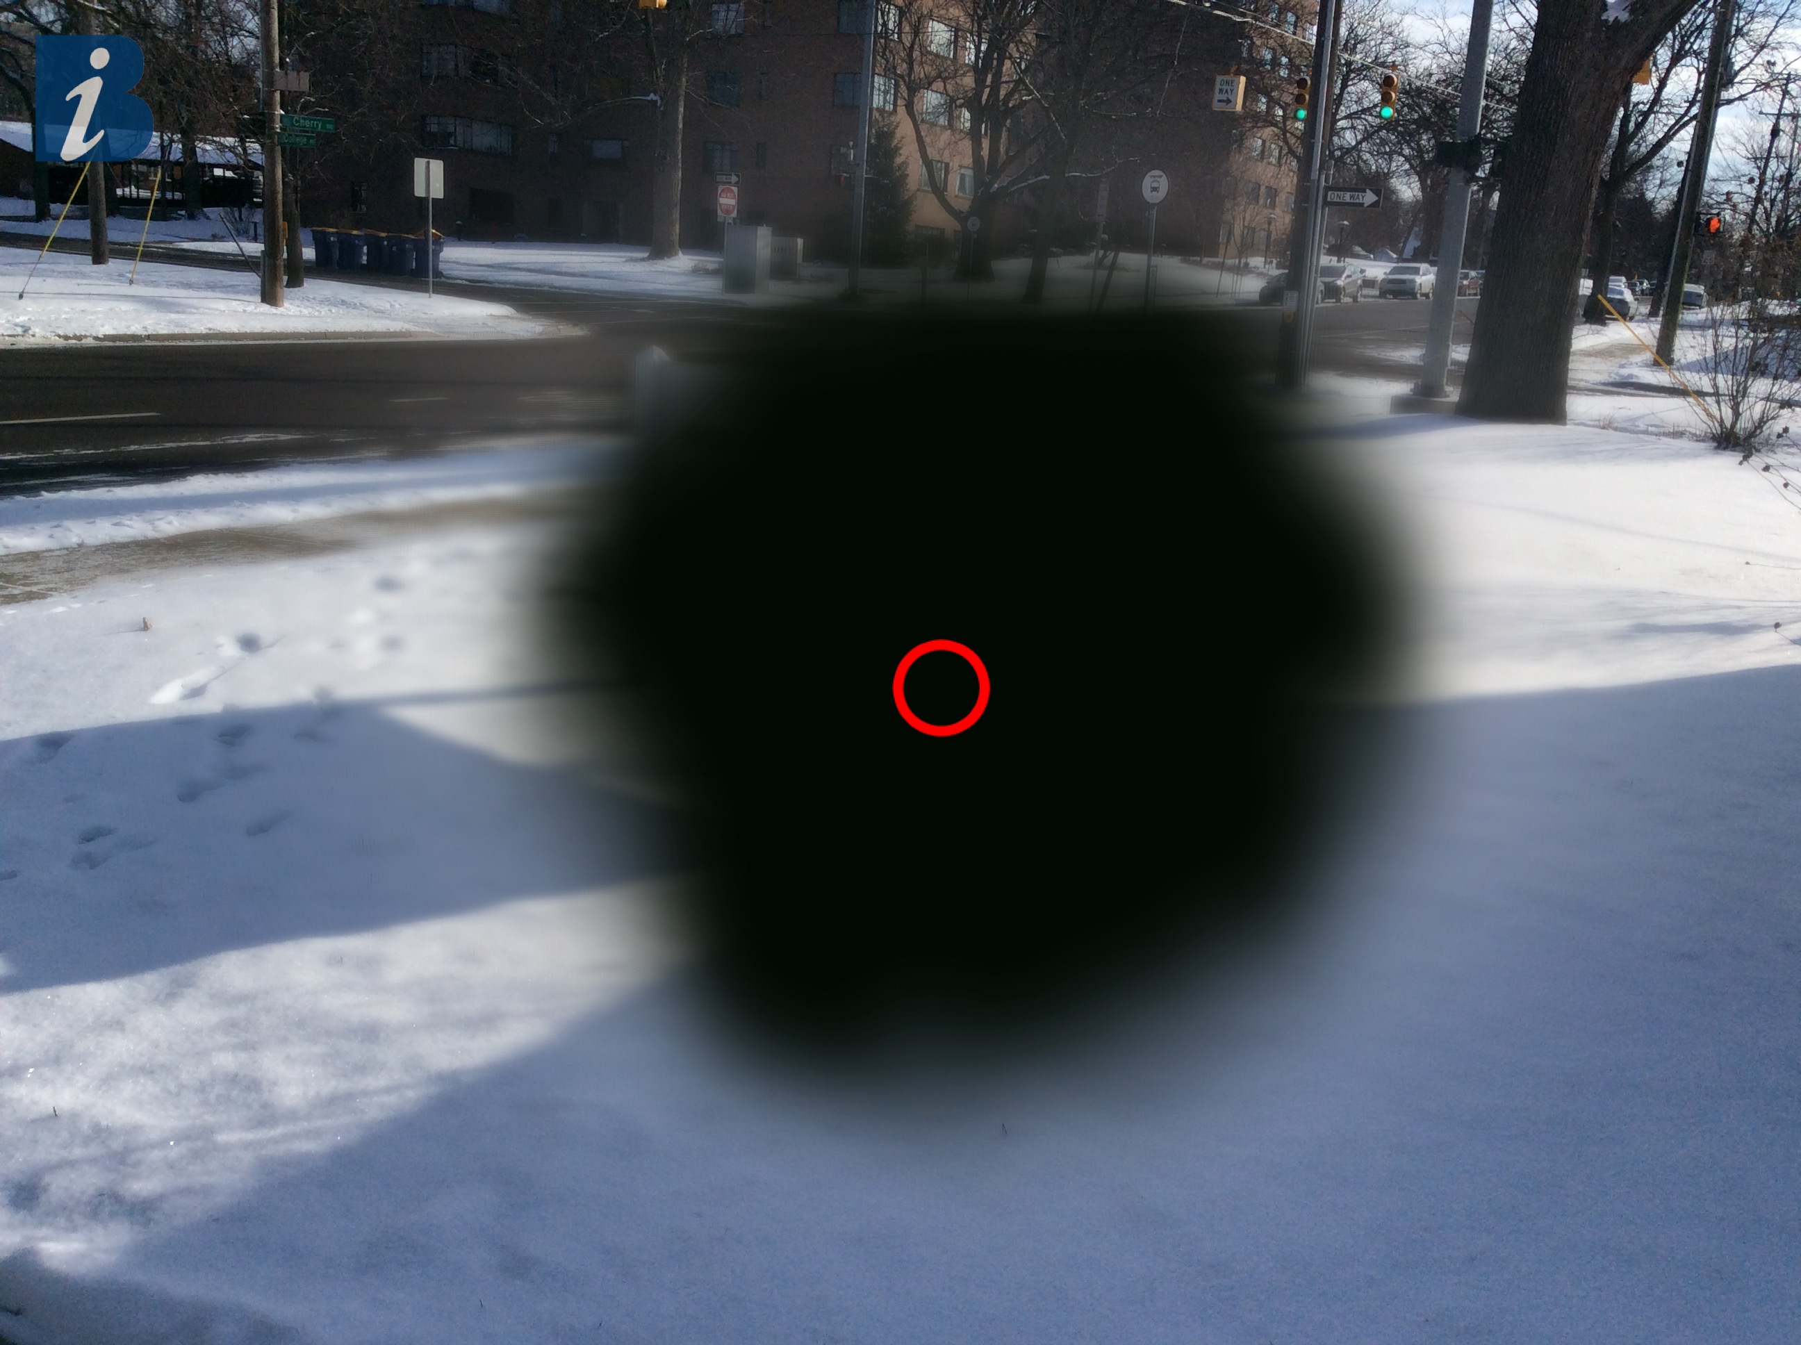
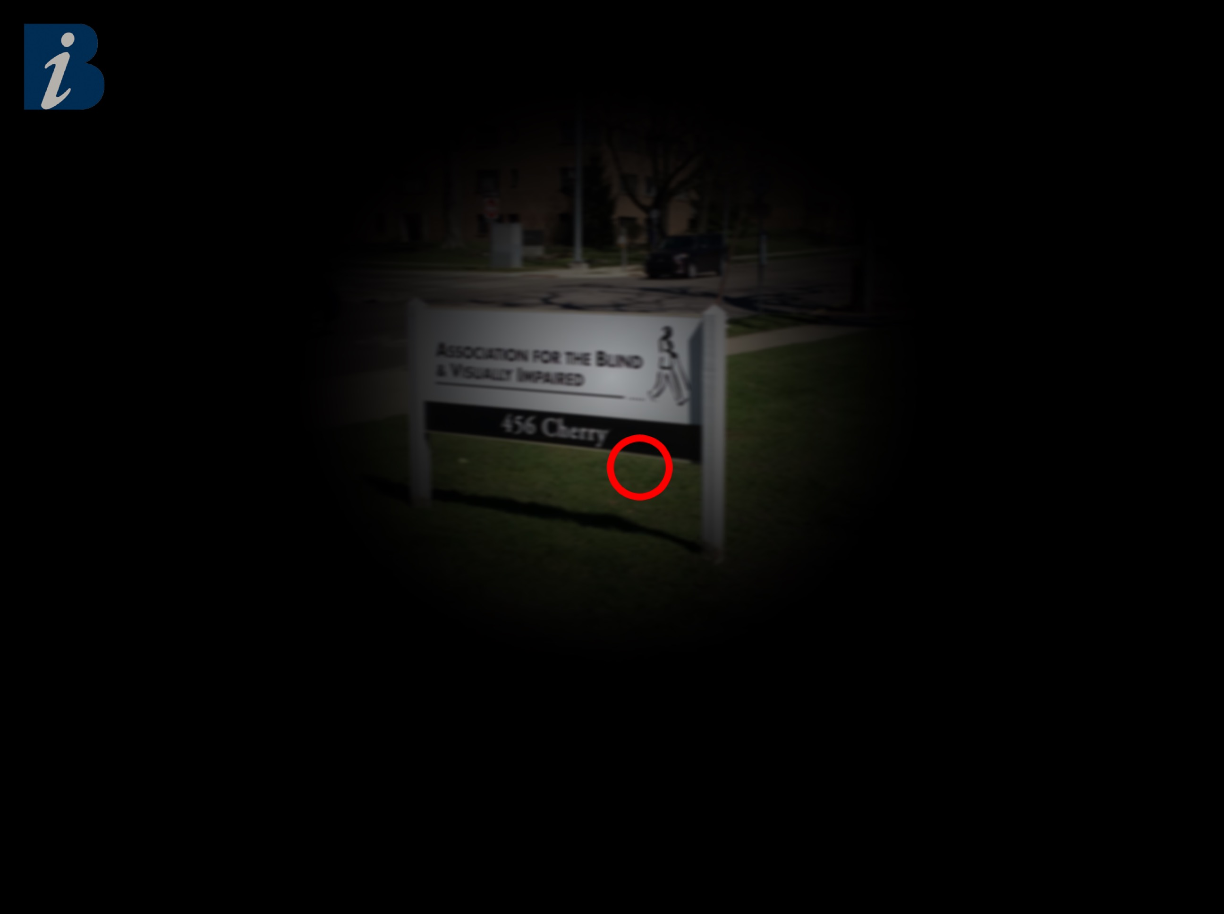
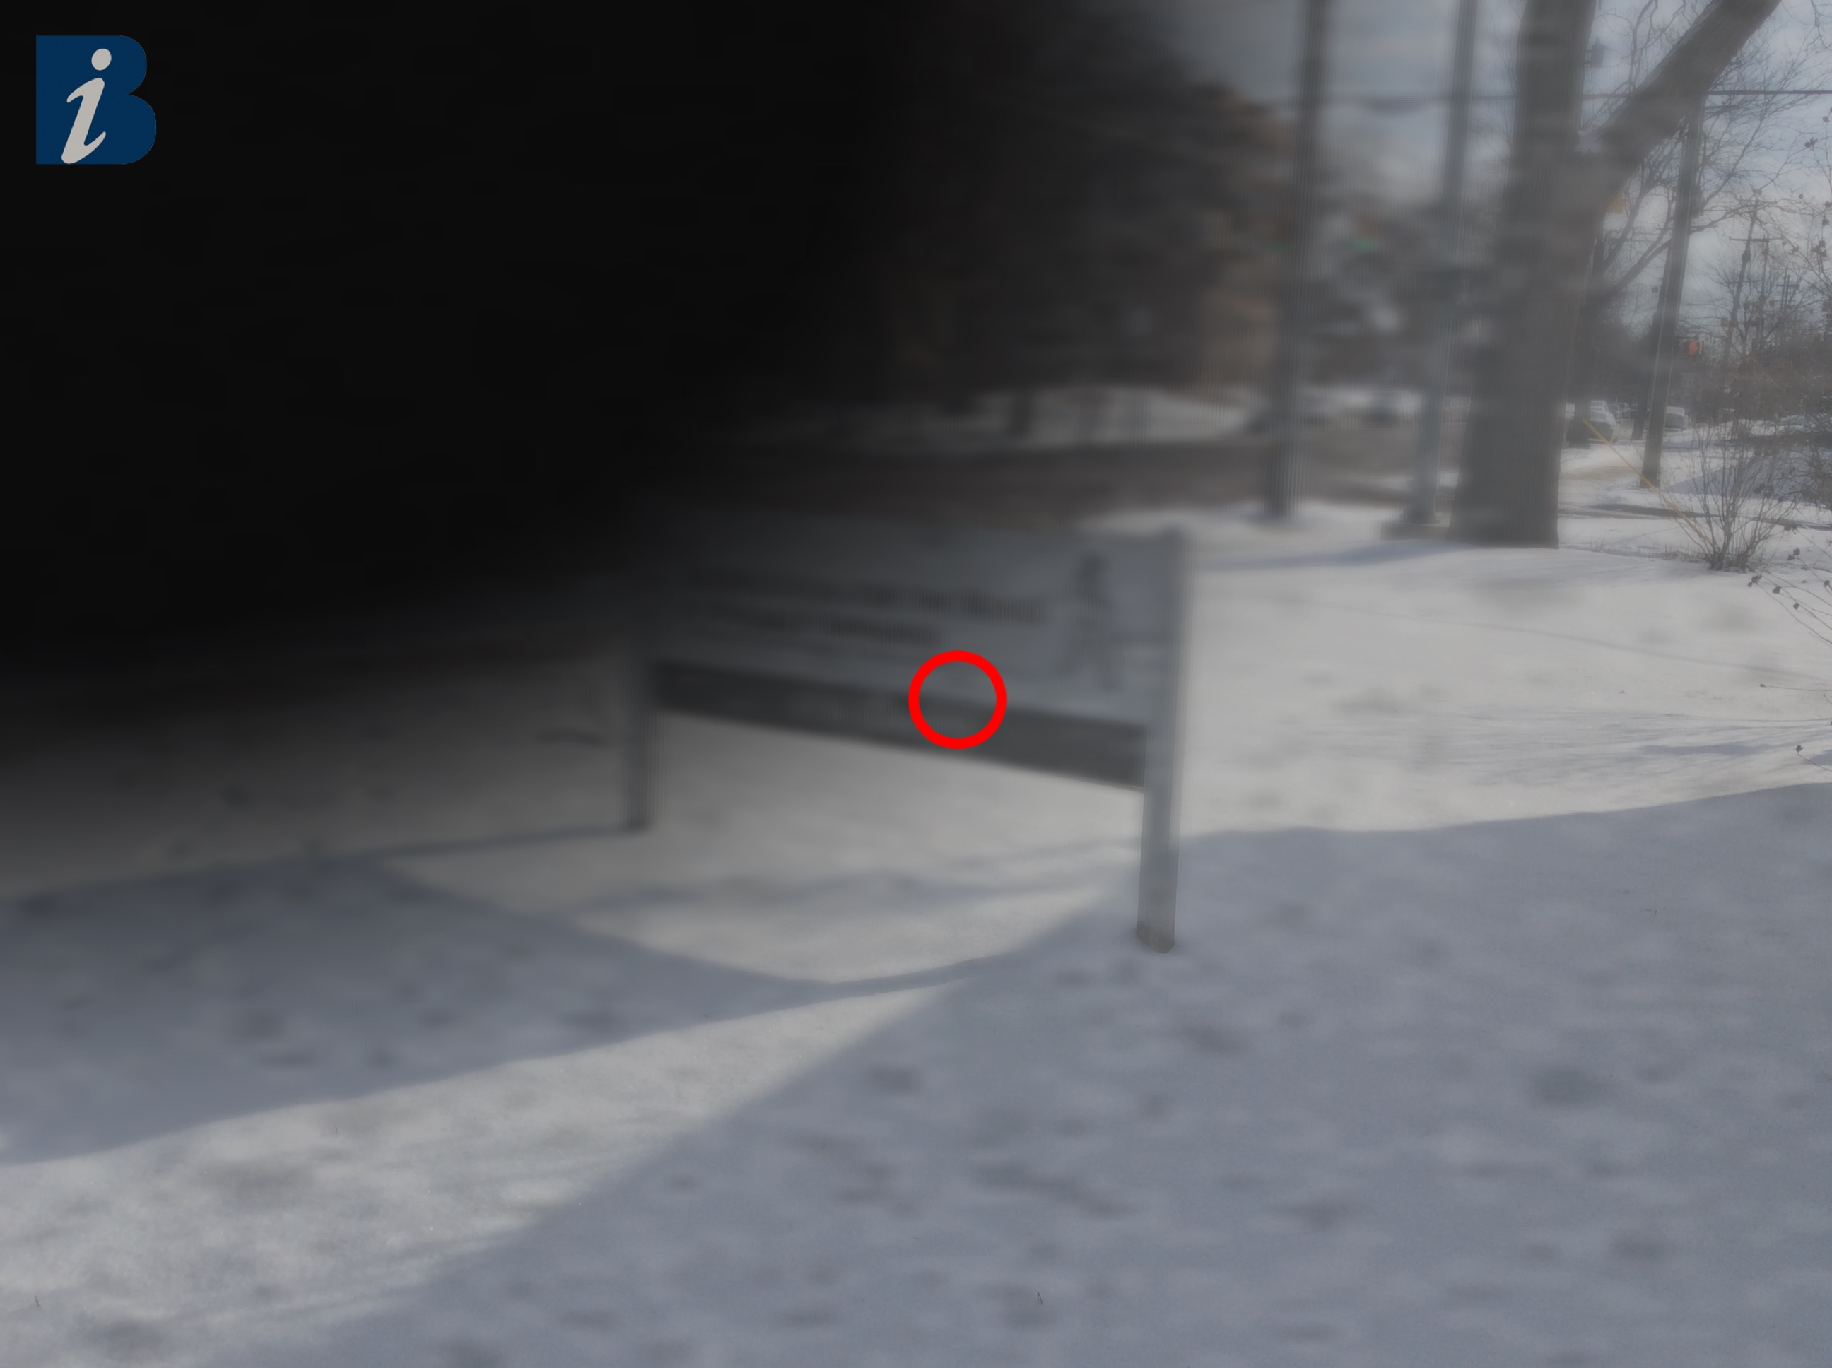
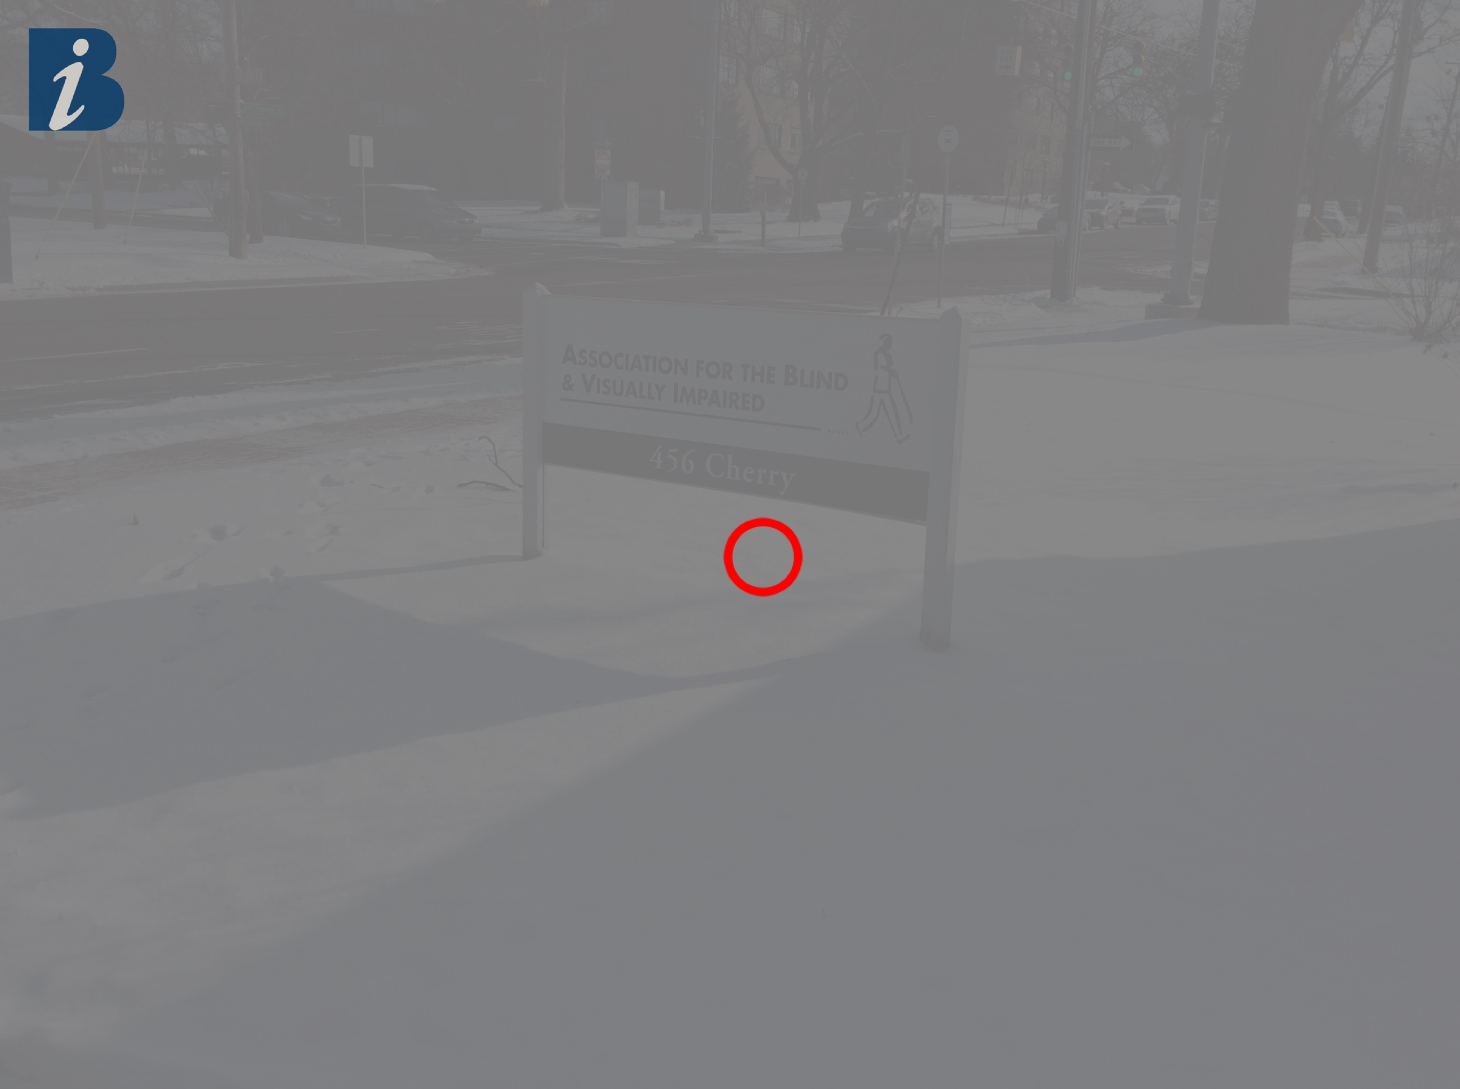
Utilizing Software Engineering and Cloud Computing Principles to Develop the Revised Self-Report Assessment of Functional Visual Performance
(R-SRAFVP) Application
Macular Degeneration⁽¹⁾
Glaucoma⁽¹⁾
CIS693 Final Project Presentation
Kirk Hedlich
Advisor: Byron DeVries, PhD
December 16, 2021
Diabetic Retinopathy⁽¹⁾
Cataracts⁽¹⁾
(1) Hedlich, Chris. “Eye Condition Examples”. 2017. JPG.
Notes:
Many types of unique eye conditions. Here are some common ones when growing older:
Age-related Macular Degeneration,
Glaucoma,
Diabetic Retinopathy,
Cataracts
To assess these types of conditions on daily activities, a standard assessment is needed.
This is how the Revised Self-Report Assessment of Functional Visual Performance comes into play
This assessments reviews a patient’s functionality across 8 main categories:
Health Management (food and medications),
Personal Grooming (dressing/hygiene),
Meal/Laundry Preparation,
Financial Management (managing personal records, reading bills and statements, writing check/paying bills),
Using the Telephone,
Reading (e.g., books, labels, instructions, etc.),
Writing (e.g., personal lists, notes, signature, etc.),
Functional Mobility (e.g., up/downstairs, avoiding collisions/tripping, locate and read signs, adjusting to walking surface, etc.),
Personal Activities (e.g., leisure activities, operating a radio/TV/phone/remotes, etc.)

Slide 2
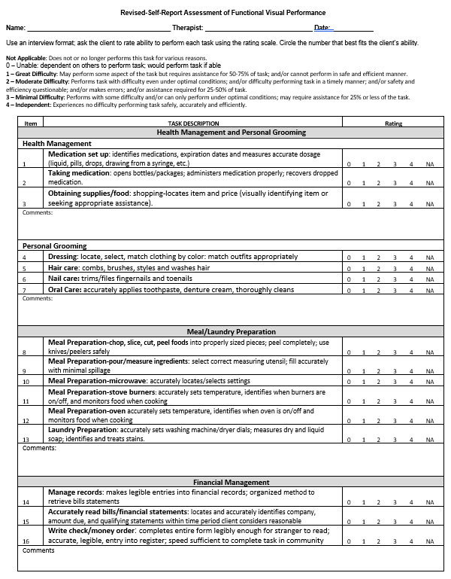
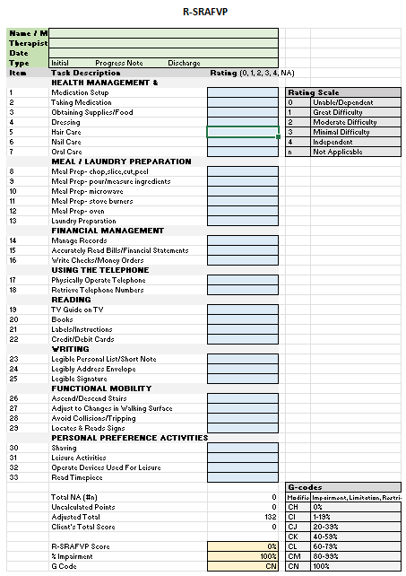
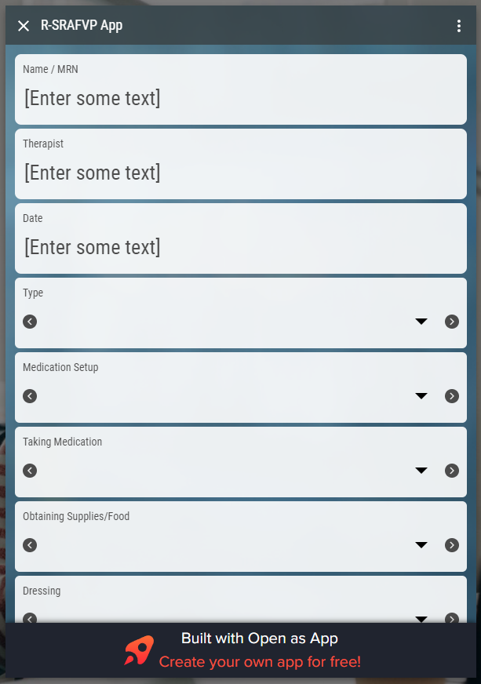
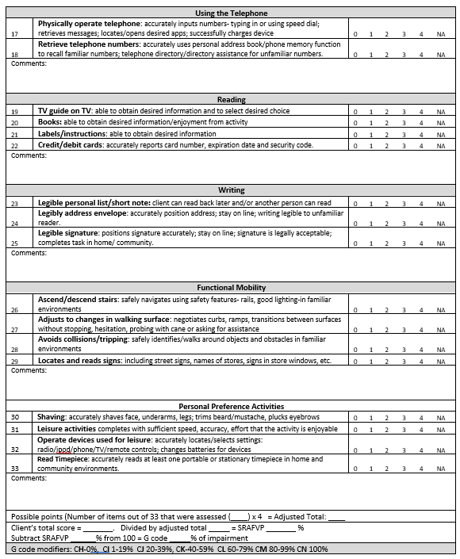
What are the current assessment methods?
Word processor/ PDF version⁽²⁾
Spreadsheet version⁽²⁾
R-SRAFVP App⁽³⁾
(2) “R-SRAFVP.” University of Alabama at Birmingham, 21 Feb. 2018.
(3) Mohiuddin, Omar. “R-SRAFVP App.” Open as App - Instantly Open Your Data as an App, https://www.openasapp.net/portal#!/client/app/ed9f4600-e824-4447-8d3f-5a550bf5c601.
CIS693 – Final Project Presentation
Kirk Hedlich, Dec. 16, 2021

Slide 3
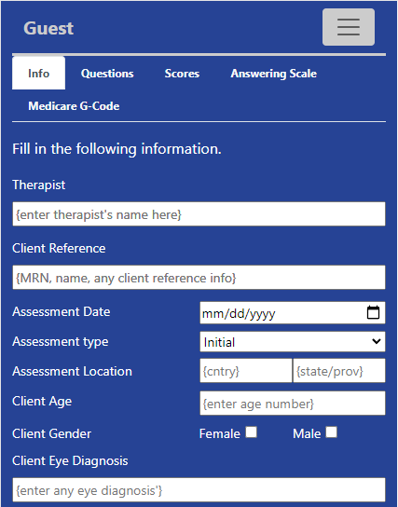
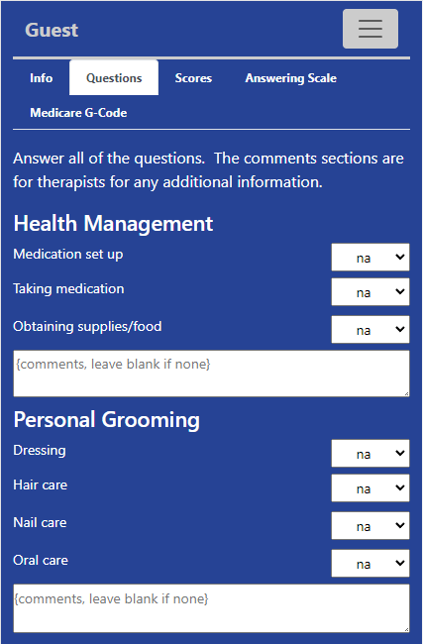
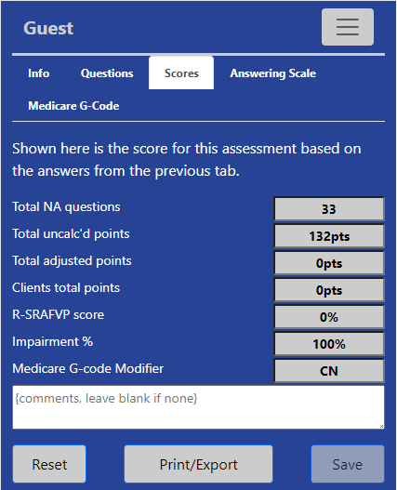
How does this project change the status quo?
CIS693 – Final Project Presentation
Kirk Hedlich, Dec. 16, 2021

Slide 4
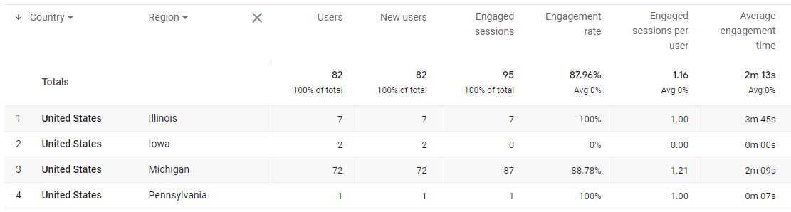
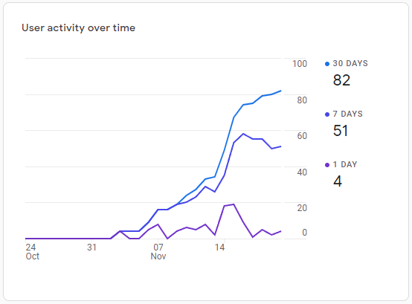
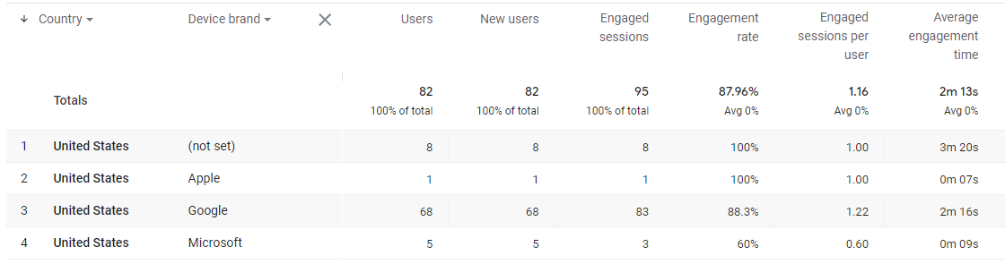
Outcomes/Results?
www.rsrafvp.com
Where are users coming from?
How many users?
What types of devices are hitting the site?
CIS693 – Final Project Presentation
Kirk Hedlich, Dec. 16, 2021

